Slide 1
Introduction to Differential Equations – Lecture 17
Fei Qi
fei.qi@du.edu
https://feiqimath.github.io

Slide 2
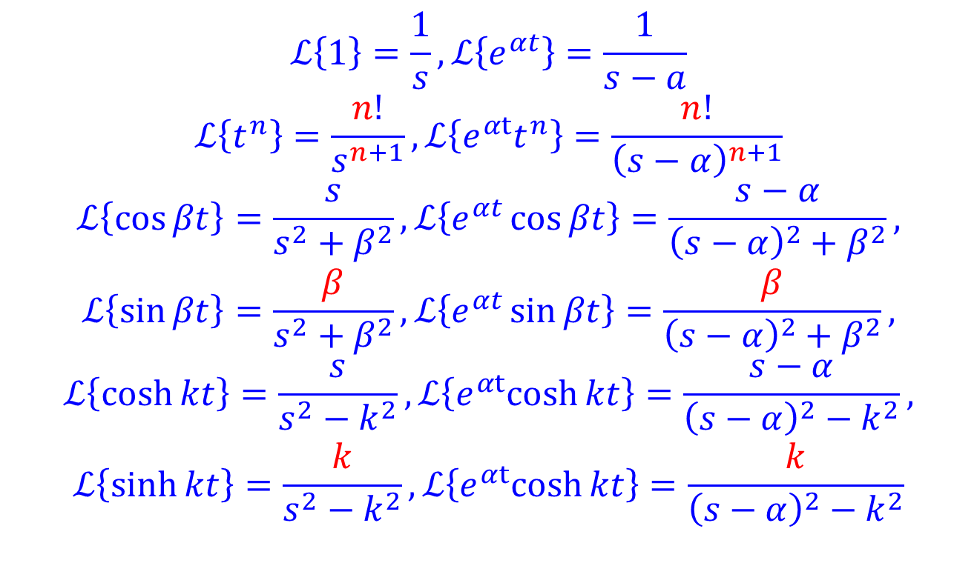
Important formulas to keep in mind
$$ℒ\left\{1\right\}=\frac{1}{s},ℒ\left\{e^{αt}\right\}=\frac{1}{s−a}$$
$$ℒ\left\{t^{n}\right\}=\frac{n!}{s^{n+1}},ℒ\left\{{e^{αt}t}^{n}\right\}=\frac{n!}{{\left(s−α\right)}^{n+1}}$$
$$ℒ\left\{\cos{βt}\right\}=\frac{s}{s^{2}+β^{2}},ℒ\left\{e^{αt}\cos{βt}\right\}=\frac{s−α}{{\left(s−α\right)}^{2}+β^{2}},$$
$$ℒ\left\{\sin{βt}\right\}=\frac{β}{s^{2}+β^{2}}, ℒ\left\{e^{αt}\sin{βt}\right\}=\frac{β}{{\left(s−α\right)}^{2}+β^{2}},$$
$$ℒ\left\{\cosh{kt}\right\}=\frac{s}{s^{2}−k^{2}},ℒ\left\{e^{αt}cosh{kt}\right\}=\frac{s−α}{{\left(s−α\right)}^{2}−k^{2}},$$
$$ℒ\left\{\sinh{kt}\right\}=\frac{k}{s^{2}−k^{2}},ℒ\left\{e^{αt}cosh{kt}\right\}=\frac{k}{{\left(s−α\right)}^{2}−k^{2}}$$

Slide 3
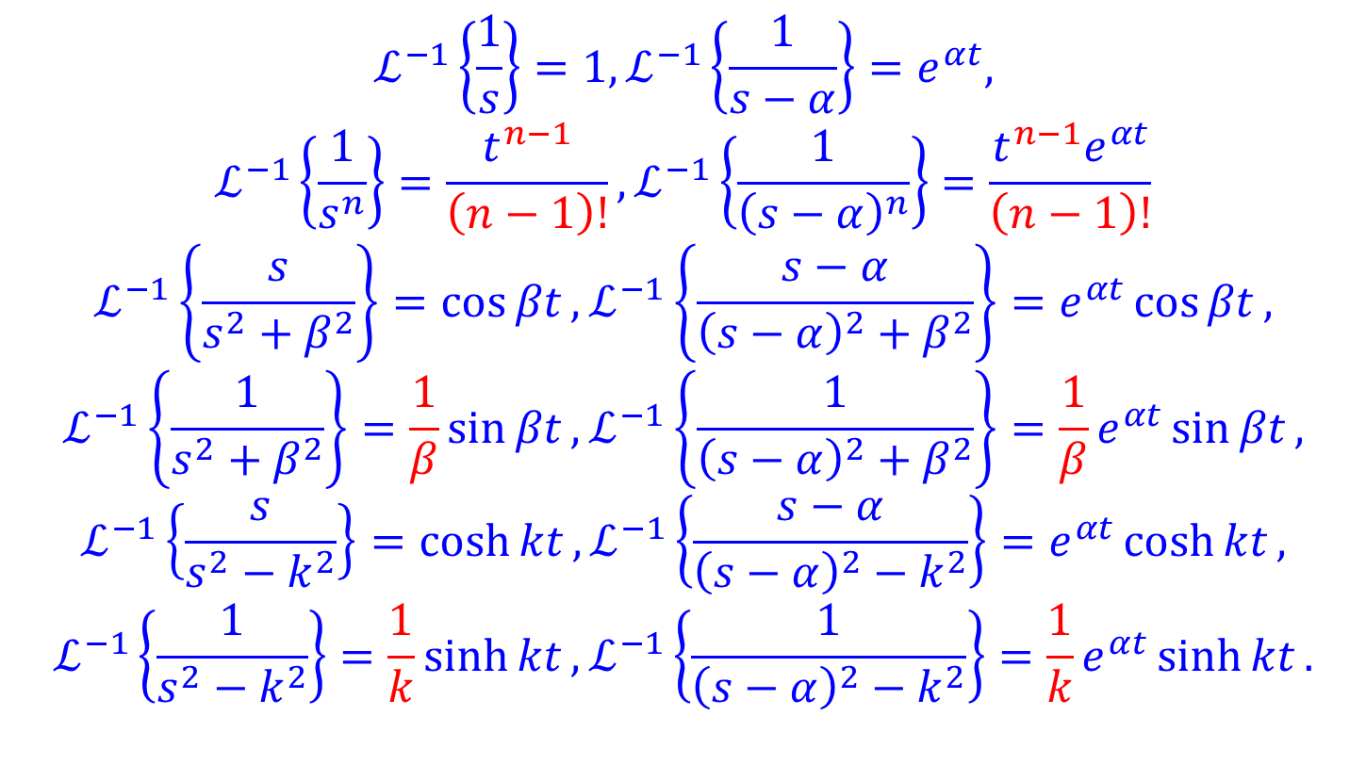
Important formulas to keep in mind
$$ℒ^{−1}\left\{\frac{1}{s}\right\}=1,ℒ^{−1}\left\{\frac{1}{s−α}\right\}=e^{αt},$$
$$ℒ^{−1}\left\{\frac{1}{s^{n}}\right\}=\frac{t^{n−1}}{\left(n−1\right)!}, ℒ^{−1}\left\{\frac{1}{{\left(s−α\right)}^{n}}\right\}=\frac{t^{n−1}e^{αt}}{\left(n−1\right)!}$$
$$ℒ^{−1}\left\{\frac{s}{s^{2}+β^{2}}\right\}=\cos{βt}, ℒ^{−1}\left\{\frac{s−α}{{\left(s−α\right)}^{2}+β^{2}}\right\}=e^{αt}\cos{βt},$$
$${ℒ^{−1}\left\{\frac{1}{s^{2}+β^{2}}\right\}=\frac{1}{β}\sin{βt},ℒ}^{−1}\left\{\frac{1}{{\left(s−α\right)}^{2}+β^{2}}\right\}=\frac{1}{β}e^{αt}\sin{βt},$$
$$ℒ^{−1}\left\{\frac{s}{s^{2}−k^{2}}\right\}=\cosh{kt},ℒ^{−1}\left\{\frac{s−α}{{\left(s−α\right)}^{2}−k^{2}}\right\}=e^{αt}\cosh{kt},$$
$$ℒ^{−1}\left\{\frac{1}{s^{2}−k^{2}}\right\}=\frac{1}{k}\sinh{kt}, ℒ^{−1}\left\{\frac{1}{{\left(s−α\right)}^{2}−k^{2}}\right\}=\frac{1}{k}e^{αt}\sinh{kt}.$$

Slide 4
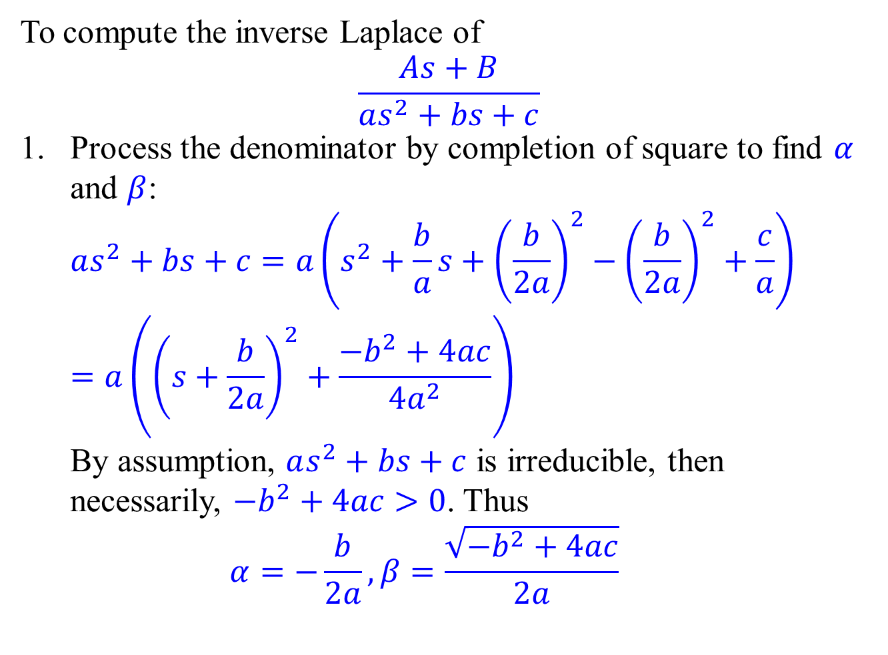
Remark on the irreducible quadratic case
To compute the inverse Laplace of
$$\frac{As+B}{as^{2}+bs+c}$$
Process the denominator by completion of square to find $α$ and $β$: $as^{2}+bs+c=a\left(s^{2}+\frac{b}{a}s+{\left(\frac{b}{2a}\right)}^{2}−{\left(\frac{b}{2a}\right)}^{2}+\frac{c}{a}\right)$ $=a\left({\left(s+\frac{b}{2a}\right)}^{2}+\frac{−b^{2}+4ac}{4a^{2}}\right)$ By assumption, $as^{2}+bs+c$ is irreducible, then necessarily, $−b^{2}+4ac>0$. Thus $α=−\frac{b}{2a},β=\frac{\sqrt{−b^{2}+4ac}}{2a}$

Slide 5
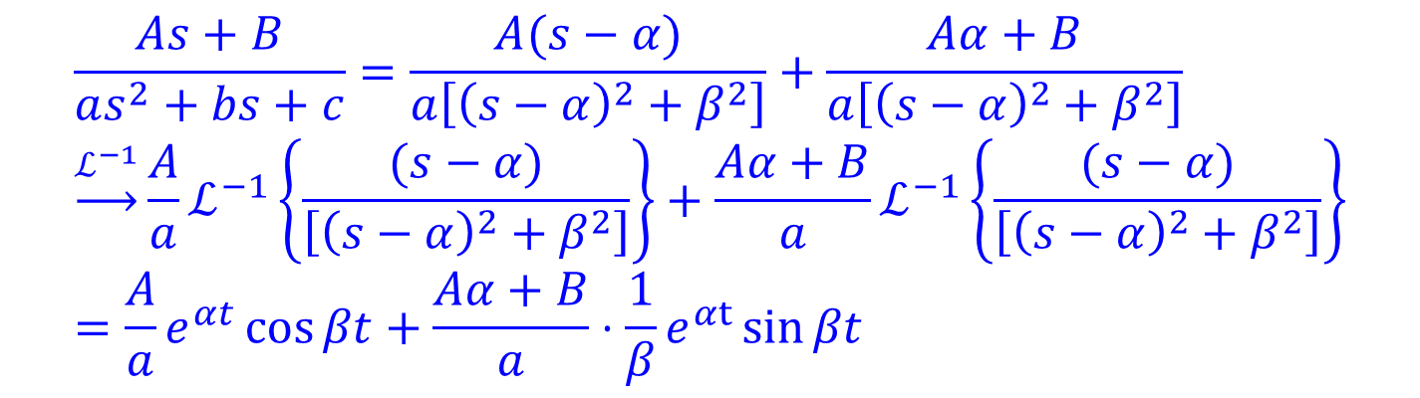
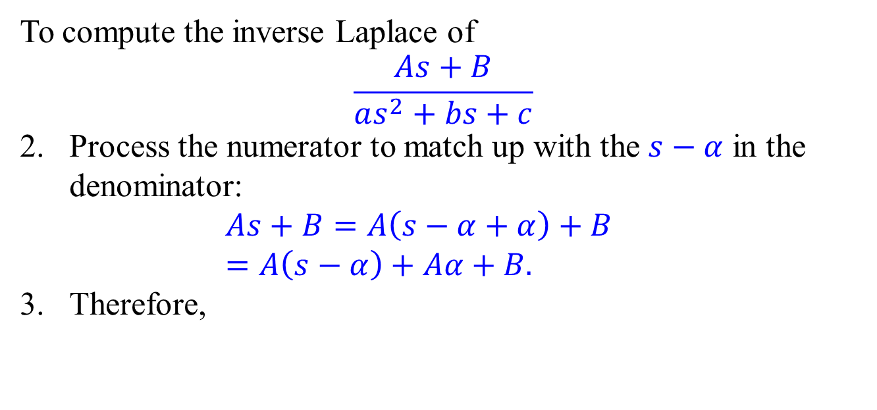
Remark on the irreducible quadratic case
To compute the inverse Laplace of
$$\frac{As+B}{as^{2}+bs+c}$$
Process the numerator to match up with the $s−α$ in the denominator: $As+B=A\left(s−α+α\right)+B$ $=A\left(s−α\right)+Aα+B.$
Therefore,
$$\frac{As+B}{as^{2}+bs+c}=\frac{A(s−α)}{a\left[{\left(s−α\right)}^{2}+β^{2}\right]}+\frac{Aα+B}{a\left[{\left(s−α\right)}^{2}+β^{2}\right]} \\ \underset{→}{ℒ^{−1}}\frac{A}{a}ℒ^{−1}\left\{\frac{(s−α)}{\left[{\left(s−α\right)}^{2}+β^{2}\right]}\right\}+\frac{Aα+B}{a}ℒ^{−1}\left\{\frac{(s−α)}{\left[{\left(s−α\right)}^{2}+β^{2}\right]}\right\} \\ =\frac{A}{a}e^{αt}\cos{βt}+\frac{Aα+B}{a}⋅\frac{1}{β}e^{αt}\sin{βt}$$

Slide 6
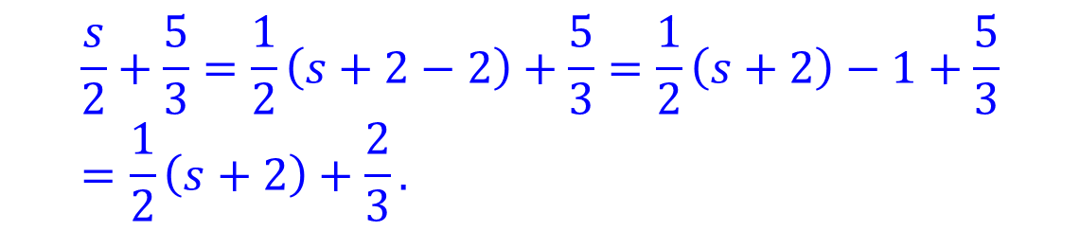

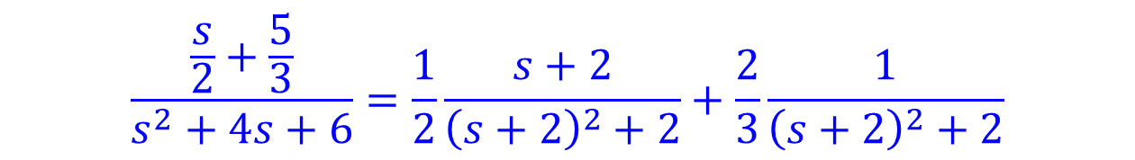
Remark on the irreducible quadratic case
It is not recommended that you memorize formulas for $α,β$. Rather, you should carry out the procedure.
Example.
$$\frac{\frac{s}{2}+\frac{5}{3}}{s^{2}+4s+6}$$
$s^{2}+4s+6=s^{2}+4s+4−4+6={\left(s+2\right)}^{2}+2.$ So, $α=−2,β=\sqrt{2}.$
So,
$$\frac{s}{2}+\frac{5}{3}=\frac{1}{2}\left(s+2−2\right)+\frac{5}{3}=\frac{1}{2}\left(s+2\right)−1+\frac{5}{3} \\ =\frac{1}{2}\left(s+2\right)+\frac{2}{3}.$$
$$\frac{\frac{s}{2}+\frac{5}{3}}{s^{2}+4s+6}=\frac{1}{2}\frac{s+2}{{\left(s+2\right)}^{2}+2}+\frac{2}{3}\frac{1}{{\left(s+2\right)}^{2}+2}$$

Slide 7
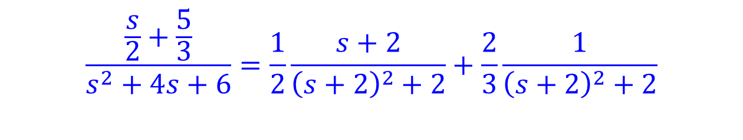
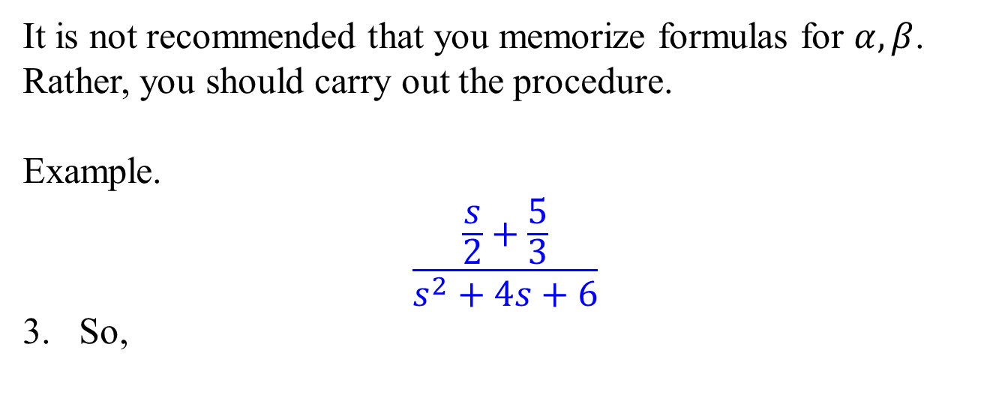
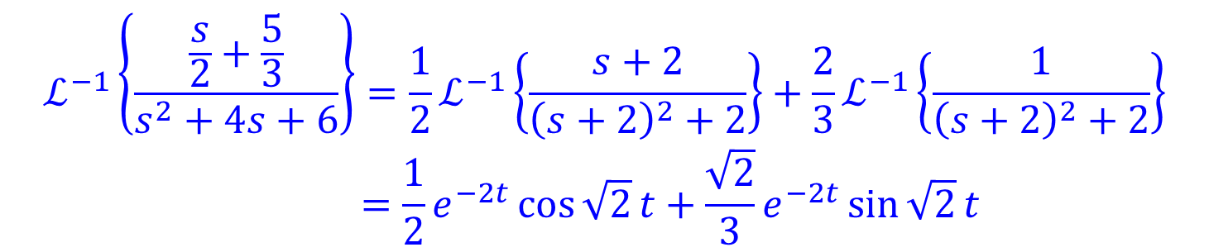
Remark on the irreducible quadratic case
It is not recommended that you memorize formulas for $α,β$. Rather, you should carry out the procedure.
Example.
$$\frac{\frac{s}{2}+\frac{5}{3}}{s^{2}+4s+6}$$
So,
$$\frac{\frac{s}{2}+\frac{5}{3}}{s^{2}+4s+6}=\frac{1}{2}\frac{s+2}{{\left(s+2\right)}^{2}+2}+\frac{2}{3}\frac{1}{{\left(s+2\right)}^{2}+2}$$
$$ℒ^{−1}\left\{\frac{\frac{s}{2}+\frac{5}{3}}{s^{2}+4s+6}\right\}={\frac{1}{2}ℒ}^{−1}\left\{\frac{s+2}{{\left(s+2\right)}^{2}+2}\right\}+\frac{2}{3}ℒ^{−1}\left\{\frac{1}{{\left(s+2\right)}^{2}+2}\right\} \\ =\frac{1}{2}e^{−2t}\cos{\sqrt{2}}t+\frac{\sqrt{2}}{3}e^{−2t}\sin{\sqrt{2}}t$$

Slide 8




Unit step function and piecewise function
Definition. The function
$$𝒰\left(t−a\right)=\left\{\begin{aligned}0, 0≤t<a \\ &1, t≥a\end{aligned}\right.$$
is called the unit step function (Heaviside step function).
Any piecewise function can be expressed as a (possible infinite) sum of functions with unit step functions.
$$1$$
$$0$$
$$a$$

Slide 9
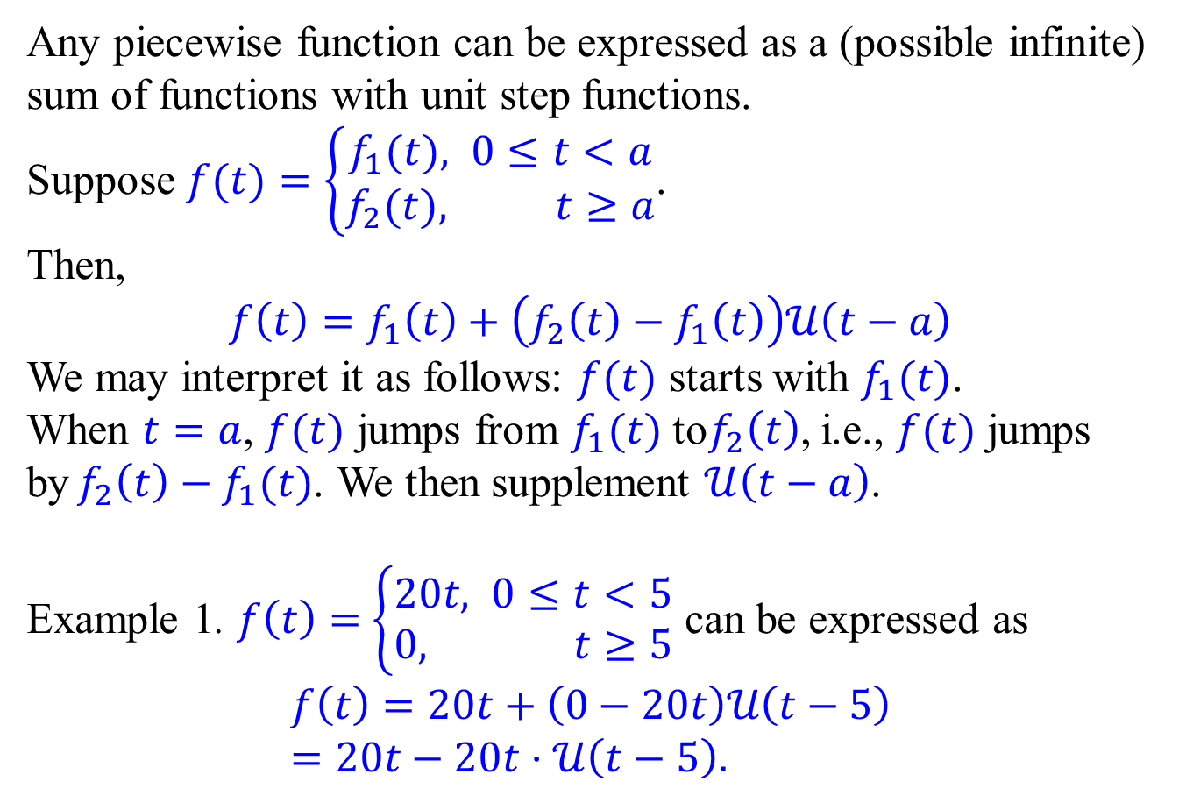
Unit step function and piecewise function
Any piecewise function can be expressed as a (possible infinite) sum of functions with unit step functions.
Suppose $f(t)=\left\{\begin{aligned}f_{1}(t), 0≤t<a \\ &f_{2}(t), t≥a\end{aligned}\right.$.
Then,
$$f\left(t\right)=f_{1}\left(t\right)+\left(f_{2}\left(t\right)−f_{1}\left(t\right)\right)𝒰\left(t−a\right)$$
We may interpret it as follows: $f(t)$ starts with $f_{1}(t)$. When $t=a$, $f(t)$ jumps from $f_{1}(t)$ to$f_{2}\left(t\right)$, i.e., $f(t)$ jumps by$f_{2}\left(t\right)−f_{1}(t)$. We then supplement $𝒰\left(t−a\right)$.
Example 1. $f\left(t\right)=$ $\left\{\begin{aligned}20t, 0≤t<5 \\ &0, t≥5\end{aligned}\right.$ can be expressed as
$$f\left(t\right)=20t+\left(0−20t\right)𝒰\left(t−5\right) \\ =20t−20t⋅𝒰\left(t−5\right).$$

Slide 10
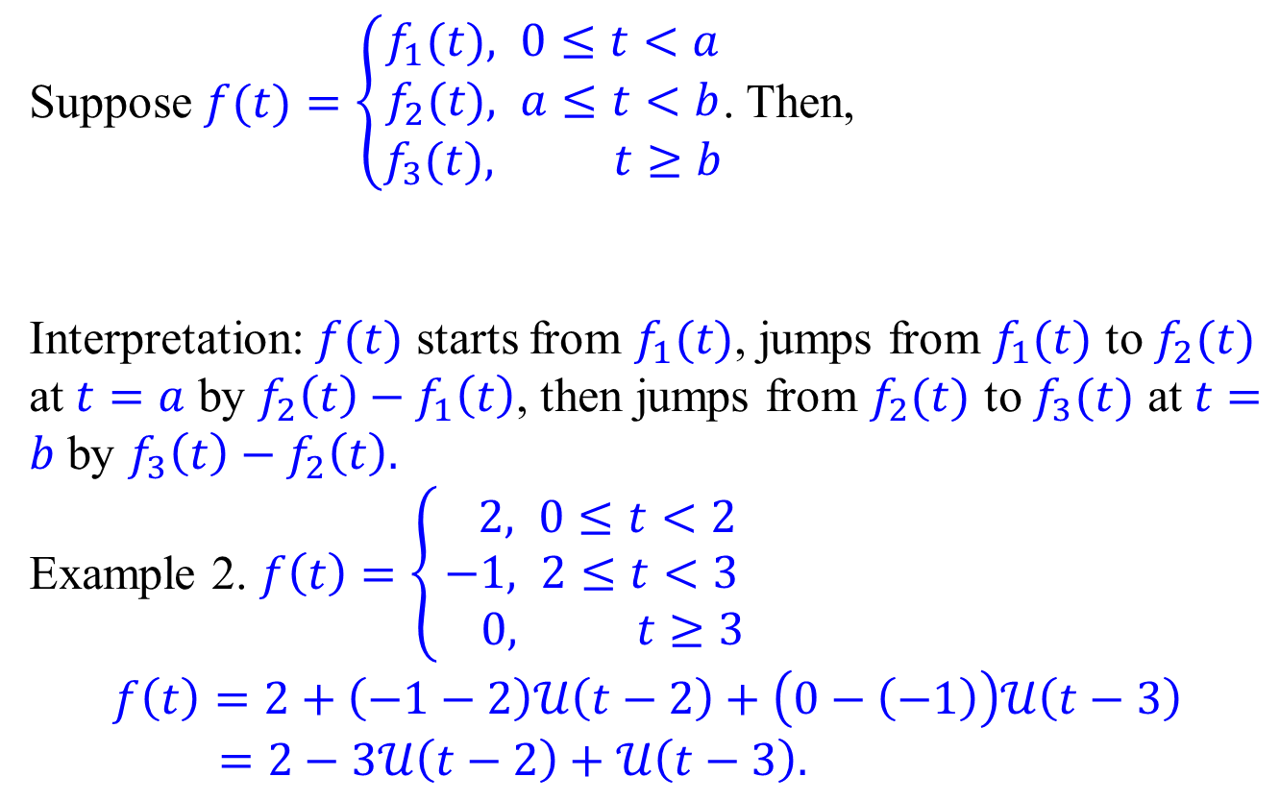
Unit step function and piecewise function
Suppose $f(t)=\left\{\begin{aligned}f_{1}(t), 0≤t<a \\ &f_{2}(t), a≤t<b \\ f_{3}(t), t≥b\end{aligned}\right.$. Then,
Interpretation: $f(t)$ starts from $f_{1}(t)$, jumps from $f_{1}(t)$ to $f_{2}(t)$ at $t=a$ by $f_{2}\left(t\right)−f_{1}\left(t\right)$, then jumps from $f_{2}(t)$ to $f_{3}(t)$ at $t=b$ by $f_{3}\left(t\right)−f_{2}\left(t\right).$
Example 2. $f\left(t\right)=\left\{\begin{aligned} 2, 0≤t<2 \\ &−1, 2≤t<3 \\ 0, t≥3\end{aligned}\right.$
$$f\left(t\right)=2+\left(−1−2\right)𝒰\left(t−2\right)+\left(0−\left(−1\right)\right)𝒰\left(t−3\right) \\ =2−3𝒰\left(t−2\right)+𝒰\left(t−3\right).$$
$$f\left(t\right)=f_{1}\left(t\right)+\left(f_{2}\left(t\right)−f_{1}\left(t\right)\right)𝒰\left(t−a\right)+\left(f_{3}\left(t\right)−f_{2}\left(t\right)\right)𝒰\left(t−b\right)$$

Slide 11
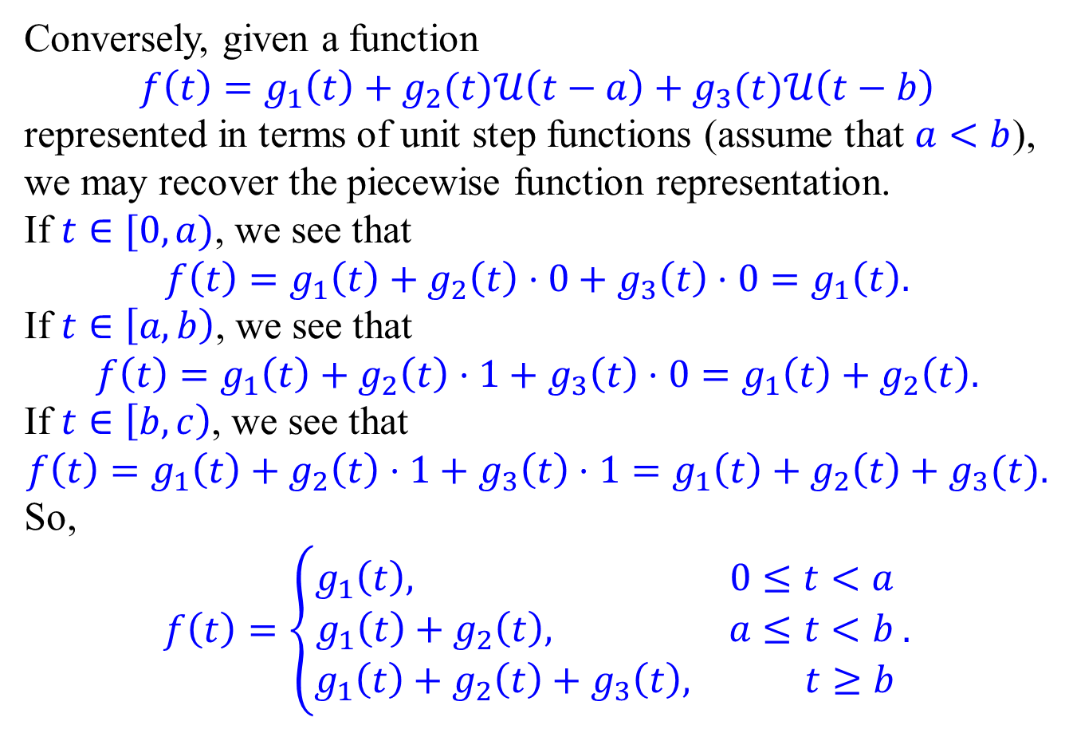
Unit step function and piecewise function
Conversely, given a function
$$f\left(t\right)=g_{1}\left(t\right)+g_{2}(t)𝒰\left(t−a\right)+g_{3}(t)𝒰\left(t−b\right)$$
represented in terms of unit step functions (assume that $a<b$), we may recover the piecewise function representation.
If $t∈[0,a)$, we see that
$$f\left(t\right)=g_{1}\left(t\right)+g_{2}\left(t\right)⋅0+g_{3}\left(t\right)⋅0=g_{1}\left(t\right).$$
If $t∈\left[a,b\right)$, we see that
$$f\left(t\right)=g_{1}\left(t\right)+g_{2}\left(t\right)⋅1+g_{3}\left(t\right)⋅0=g_{1}\left(t\right)+g_{2}\left(t\right).$$
If $t∈\left[b,c\right)$, we see that
$$f\left(t\right)=g_{1}\left(t\right)+g_{2}\left(t\right)⋅1+g_{3}\left(t\right)⋅1=g_{1}\left(t\right)+g_{2}\left(t\right)+g_{3}(t).$$
So,
$$f\left(t\right)=\left\{\begin{aligned}g_{1}\left(t\right), 0≤t<a \\ &g_{1}\left(t\right)+g_{2}\left(t\right), a≤t<b \\ g_{1}\left(t\right)+g_{2}\left(t\right)+g_{3}\left(t\right), t≥b\end{aligned}\right..$$

Slide 12
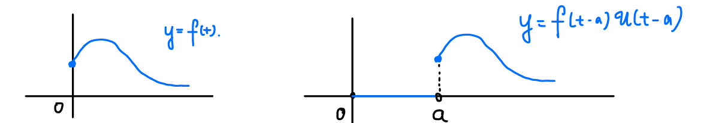
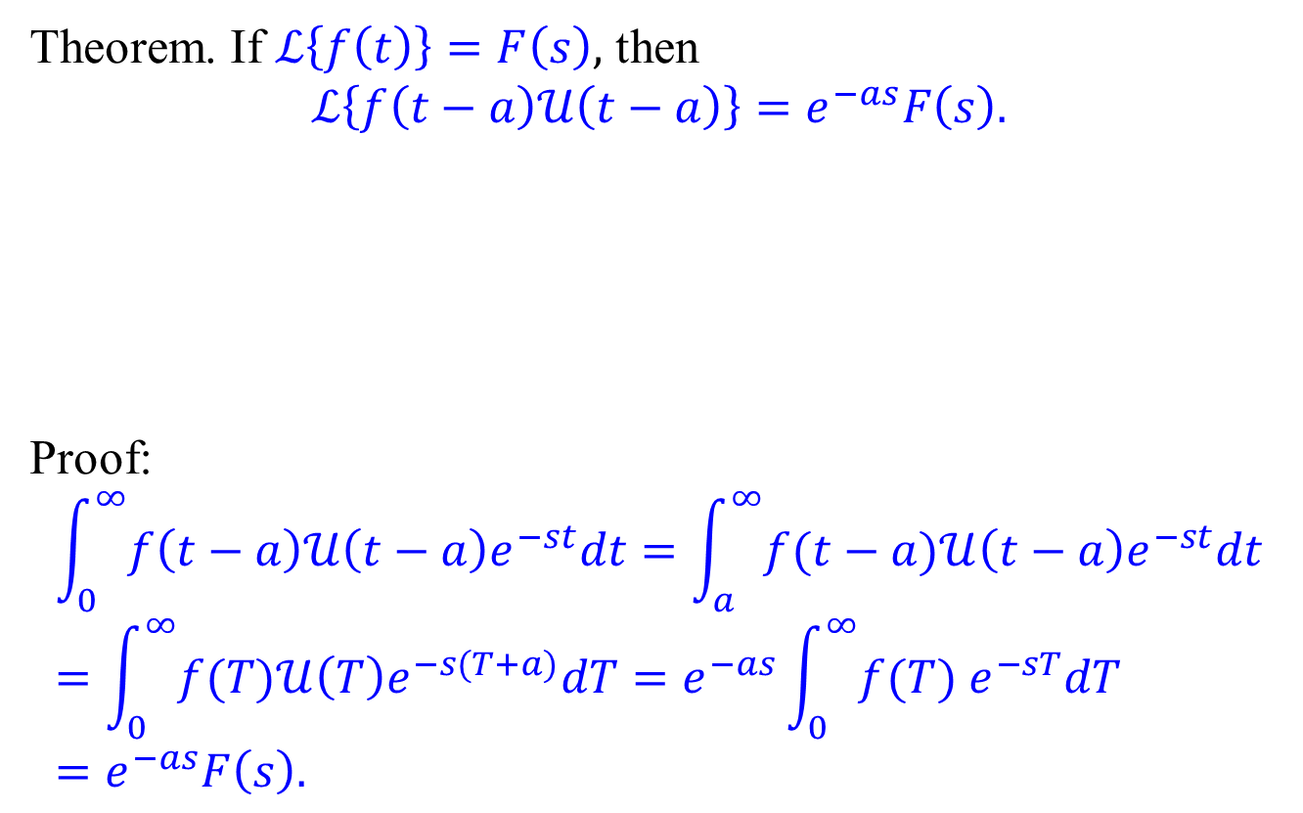
Second translation theorem
Theorem. If $ℒ\left\{f\left(t\right)\right\}=F\left(s\right),$ then
$$ℒ\left\{f\left(t−a\right)𝒰\left(t−a\right)\right\}=e^{−as}F\left(s\right).$$
Proof:
$$\int_{0}^{∞}{f\left(t−a\right)𝒰\left(t−a\right)e^{−st}dt}=\int_{a}^{∞}{f(t−a)𝒰\left(t−a\right)e^{−st}dt} \\ =\int_{0}^{∞}{f(T)𝒰\left(T\right)e^{−s(T+a)}dT}=e^{−as}\int_{0}^{∞}{f(T) e^{−sT}dT} \\ =e^{−as}F\left(s\right).$$

Slide 13
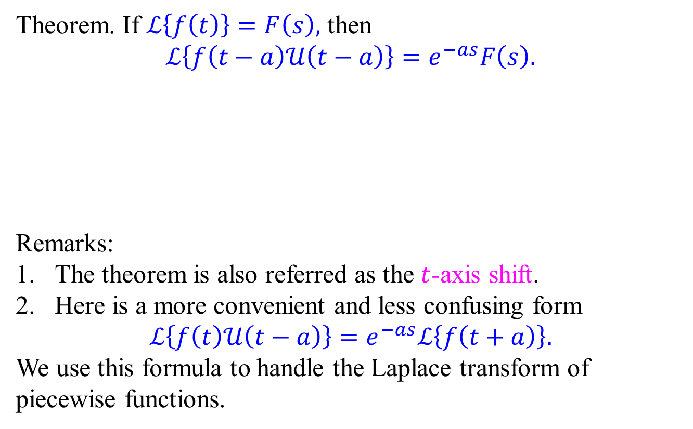
Second translation theorem
Theorem. If $ℒ\left\{f\left(t\right)\right\}=F\left(s\right),$ then
$$ℒ\left\{f\left(t−a\right)𝒰\left(t−a\right)\right\}=e^{−as}F\left(s\right).$$
Remarks:
The theorem is also referred as the $t$-axis shift.
Here is a more convenient and less confusing form
$$ℒ\left\{f\left(t\right)𝒰\left(t−a\right)\right\}=e^{−as}ℒ\left\{f\left(t+a\right)\right\}.$$ We use this formula to handle the Laplace transform of piecewise functions.

Slide 14
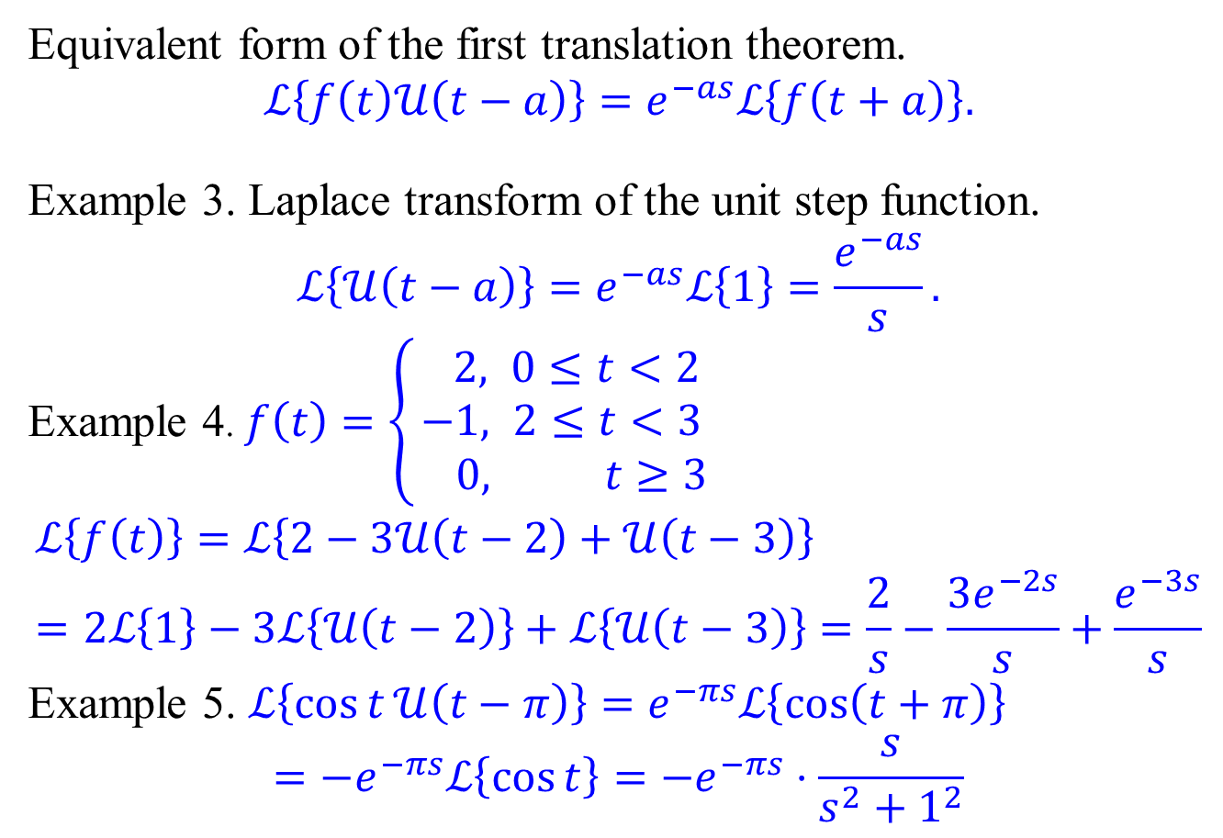
Second translation theorem - Examples
Equivalent form of the first translation theorem.
$$ℒ\left\{f\left(t\right)𝒰\left(t−a\right)\right\}=e^{−as}ℒ\left\{f\left(t+a\right)\right\}.$$
Example 3. Laplace transform of the unit step function.
$$ℒ\left\{𝒰\left(t−a\right)\right\}=e^{−as}ℒ\left\{1\right\}=\frac{e^{−as}}{s}.$$
Example 4. $f\left(t\right)=\left\{\begin{aligned} 2, 0≤t<2 \\ &−1, 2≤t<3 \\ 0, t≥3\end{aligned}\right.$
$$ℒ\left\{f\left(t\right)\right\}=ℒ\left\{2−3𝒰\left(t−2\right)+𝒰\left(t−3\right)\right\} \\ =2ℒ\left\{1\right\}−3ℒ\left\{𝒰\left(t−2\right)\right\}+ℒ\left\{𝒰\left(t−3\right)\right\}=\frac{2}{s}−\frac{3e^{−2s}}{s}+\frac{e^{−3s}}{s}$$
Example 5. $ℒ\left\{\cos{t}𝒰\left(t−π\right)\right\}=e^{−πs}ℒ\left\{\cos\left(t+π\right)\right\}$ $$={−e}^{−πs}ℒ\left\{\cos{t}\right\}={−e}^{−πs}⋅\frac{s}{s^{2}+1^{2}}$$

Slide 15
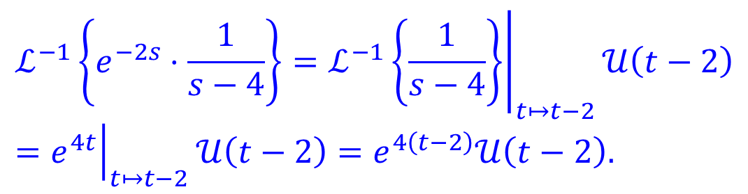

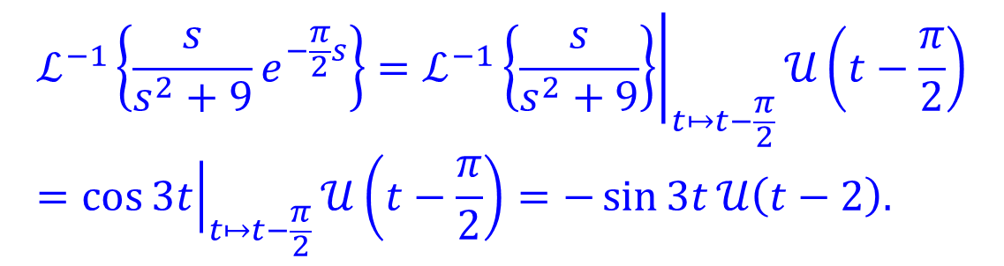
Second translation theorem – Inverse form.
Theorem. If $f\left(t\right)=ℒ^{−1}\left\{F(s)\right\}$, then
$$ℒ^{−1}\left\{e^{−as}F\left(s\right)\right\}=f\left(t−a\right)𝒰\left(t−a\right).$$
Equivalently,
$$ℒ^{−1}\left\{e^{−as}F\left(s\right)\right\}=ℒ^{−1}\left\{F\left(s\right)\right\}{\left.​\right|}_{t↦t−a}𝒰\left(t−a\right).$$
Example 5.
Example 6.
$$ℒ^{−1}\left\{e^{−2s}⋅\frac{1}{s−4}\right\}=ℒ^{−1}{\left.\left\{\frac{1}{s−4}\right\}\right|}_{t↦t−2}𝒰\left(t−2\right)={\left.e^{4t}\right|}_{t↦t−2}𝒰\left(t−2\right)=e^{4\left(t−2\right)}𝒰\left(t−2\right).$$
$$ℒ^{−1}\left\{\frac{s}{s^{2}+9}e^{−\frac{π}{2}s}\right\}=ℒ^{−1}{\left.\left\{\frac{s}{s^{2}+9}\right\}\right|}_{t↦t−\frac{π}{2}}𝒰\left(t−\frac{π}{2}\right)={\left.\cos{3t}\right|}_{t↦t−\frac{π}{2}}𝒰\left(t−\frac{π}{2}\right)=−\sin{3t}𝒰\left(t−2\right).$$

Slide 16
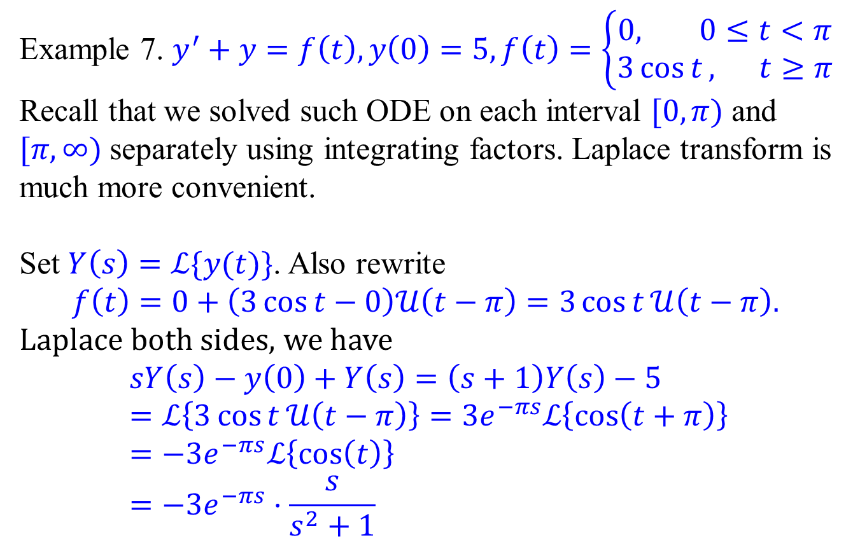
Initial value problem with piecewise functions
Example 7. $y^{′}+y=f\left(t\right),y\left(0\right)=5,f\left(t\right)=\left\{\begin{aligned}0, 0≤t<π \\ &3\cos{t}, t≥π\end{aligned}\right.$
Recall that we solved such ODE on each interval $[0,π)$ and $[π,∞)$ separately using integrating factors. Laplace transform is much more convenient.
Set $Y\left(s\right)=ℒ\{y(t)\}$. Also rewrite
$$f\left(t\right)=0+\left(3\cos{t}−0\right)𝒰\left(t−π\right)=3\cos{t}𝒰\left(t−π\right).$$
Laplace both sides, we have
$$sY\left(s\right)−y\left(0\right)+Y\left(s\right)=\left(s+1\right)Y\left(s\right)−5 \\ =ℒ\left\{3\cos{t}𝒰\left(t−π\right)\right\}=3e^{−πs}ℒ\left\{\cos\left(t+π\right)\right\}=−3e^{−πs}ℒ\left\{\cos\left(t\right)\right\} \\ =−3e^{−πs}⋅\frac{s}{s^{2}+1}$$

Slide 17
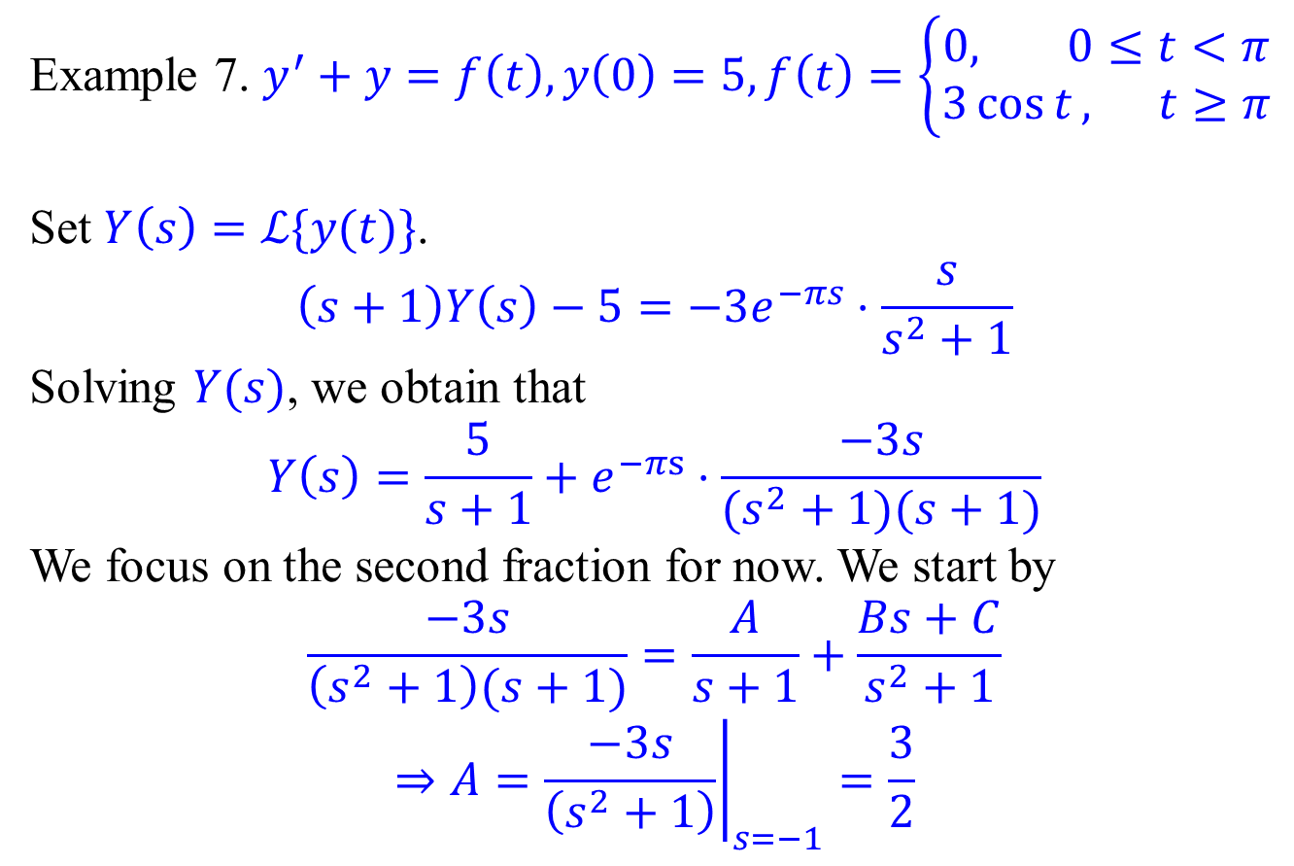
Initial value problem with piecewise functions
Example 7. $y^{′}+y=f\left(t\right),y\left(0\right)=5,f\left(t\right)=\left\{\begin{aligned}0, 0≤t<π \\ &3\cos{t}, t≥π\end{aligned}\right.$
Set $Y\left(s\right)=ℒ\{y(t)\}$.
$$\left(s+1\right)Y\left(s\right)−5=−3e^{−πs}⋅\frac{s}{s^{2}+1}$$
Solving $Y(s)$, we obtain that
$$Y\left(s\right)=\frac{5}{s+1}+e^{−πs}⋅\frac{−3s}{(s^{2}+1)(s+1)}$$
We focus on the second fraction for now. We start by
$$\frac{−3s}{\left(s^{2}+1\right)(s+1)}=\frac{A}{s+1}+\frac{Bs+C}{s^{2}+1}$$
$$⇒A={\left.\frac{−3s}{\left(s^{2}+1\right)}\right|}_{s=−1}=\frac{3}{2}$$

Slide 18
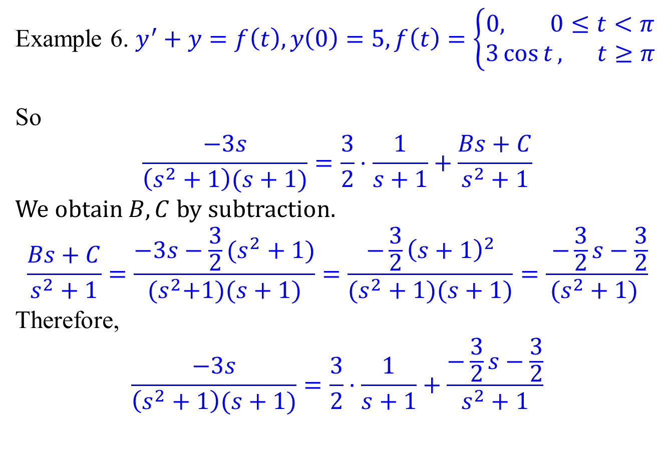
Initial value problem with piecewise functions
Example 6. $y^{′}+y=f\left(t\right),y\left(0\right)=5,f\left(t\right)=\left\{\begin{aligned}0, 0≤t<π \\ &3\cos{t}, t≥π\end{aligned}\right.$
So
$$\frac{−3s}{\left(s^{2}+1\right)(s+1)}=\frac{3}{2}⋅\frac{1}{s+1}+\frac{Bs+C}{s^{2}+1}$$
We obtain $B,C$ by subtraction.
$$\frac{Bs+C}{s^{2}+1}=\frac{−3s−\frac{3}{2}(s^{2}+1)}{{(s}^{2}+1)(s+1)}=\frac{−\frac{3}{2}{\left(s+1\right)}^{2}}{(s^{2}+1)(s+1)}=\frac{ −\frac{3}{2}s−\frac{3}{2}}{(s^{2}+1) }$$
Therefore,
$$\frac{−3s}{\left(s^{2}+1\right)(s+1)}=\frac{3}{2}⋅\frac{1}{s+1}+\frac{−\frac{3}{2}s−\frac{3}{2}}{s^{2}+1}$$

Slide 19
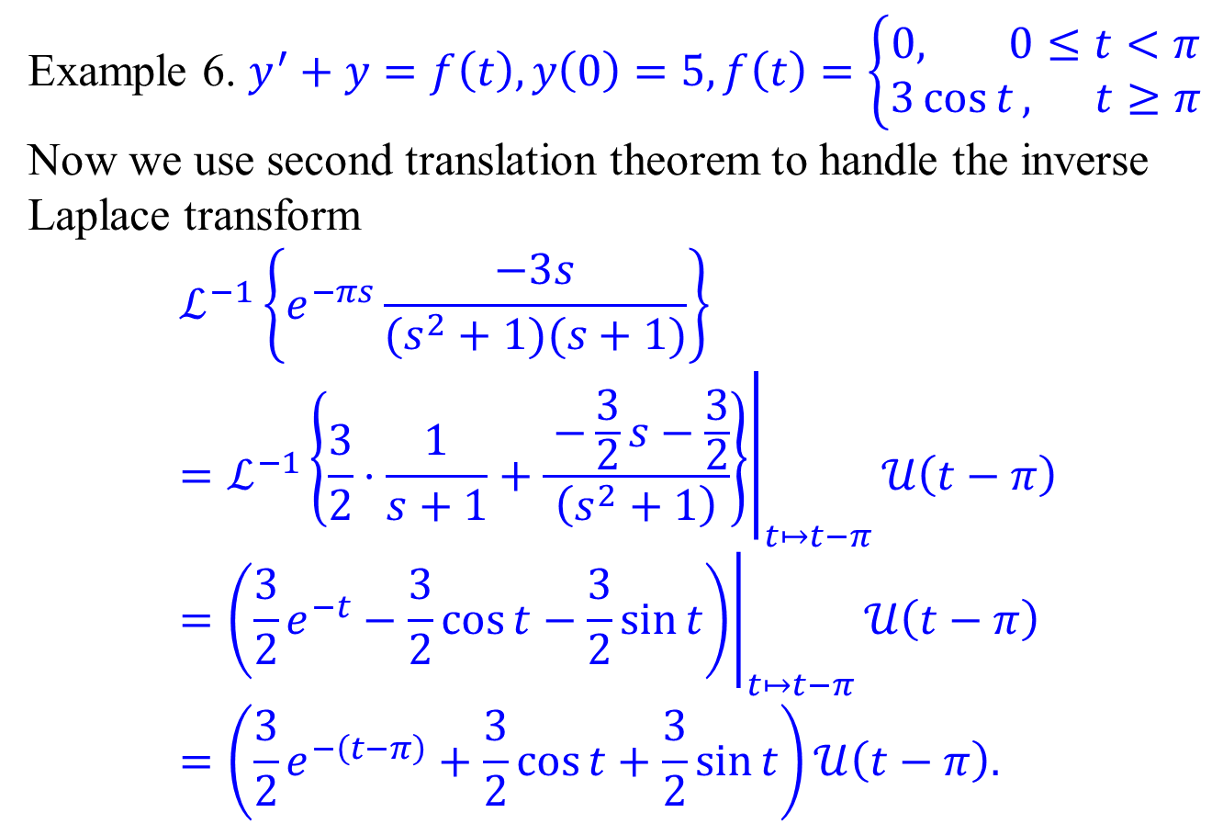
Initial value problem with piecewise functions
Example 6. $y^{′}+y=f\left(t\right),y\left(0\right)=5,f\left(t\right)=\left\{\begin{aligned}0, 0≤t<π \\ &3\cos{t}, t≥π\end{aligned}\right.$
Now we use second translation theorem to handle the inverse Laplace transform
$$ℒ^{−1}\left\{e^{−πs}\frac{−3s}{(s^{2}+1)(s+1)}\right\} \\ ={\left.ℒ^{−1}\left\{\frac{3}{2}⋅\frac{1}{s+1}+\frac{ −\frac{3}{2}s−\frac{3}{2}}{\left(s^{2}+1\right)}\right\}\right|}_{t↦t−π}𝒰\left(t−π\right) \\ ={\left.\left(\frac{3}{2}e^{−t}−\frac{3}{2}\cos{t}−\frac{3}{2}\sin{t}\right)\right|}_{t↦t−π}𝒰\left(t−π\right) \\ =\left(\frac{3}{2}e^{−\left(t−π\right)}+\frac{3}{2}\cos{t}+\frac{3}{2}\sin{t}\right)𝒰\left(t−π\right).$$

Slide 20
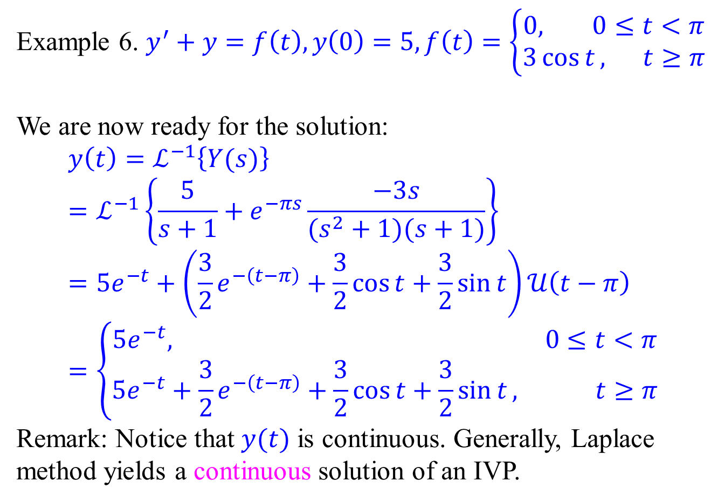
Initial value problem with piecewise functions
Example 6. $y^{′}+y=f\left(t\right),y\left(0\right)=5,f\left(t\right)=\left\{\begin{aligned}0, 0≤t<π \\ &3\cos{t}, t≥π\end{aligned}\right.$
We are now ready for the solution:
$$y\left(t\right)=ℒ^{−1}\left\{Y(s)\right\} \\ =ℒ^{−1}\left\{\frac{5}{s+1}+e^{−πs}\frac{−3s}{(s^{2}+1)(s+1)}\right\} \\ =5e^{−t}+\left(\frac{3}{2}e^{−\left(t−π\right)}+\frac{3}{2}\cos{t}+\frac{3}{2}\sin{t}\right)𝒰\left(t−π\right) \\ =\left\{\begin{aligned}5e^{−t}, 0≤t<π \\ 5e^{−t}+\frac{3}{2}e^{−\left(t−π\right)}+\frac{3}{2}\cos{t}+\frac{3}{2}\sin{t}, t≥π\end{aligned}\right.$$
Remark: Notice that $y(t)$ is continuous. Generally, Laplace method yields a continuous solution of an IVP.

